Slide 1
Team A
Project 6X6 Tic Tac Toe Game

Slide 2
Introduction
Tic Tac Toe is a game that is played with two players, X and O, who take turns marking spaces usually in a 5x5 grid.
For this project the game will be change from its most common size 3x3 to a 6x6 introducing this way more challenge to players.

Slide 3
Functional Requirements
Use Case 1:
Goals of actor: To play the game during downtime, to be entertained and to win the game.
Task: The game user starts a game. The system should create a game for the player so he/she can choose an opponent or play against the PC also allowing the user to pick the difficulty level and start a new game.
Preconditions :Clean game
Exceptions: If a game is already in process, the application will show an error message.
Notes:
GOALS: To play the game during downtime, to be entertained and to win the game.
TASKS:

Slide 4
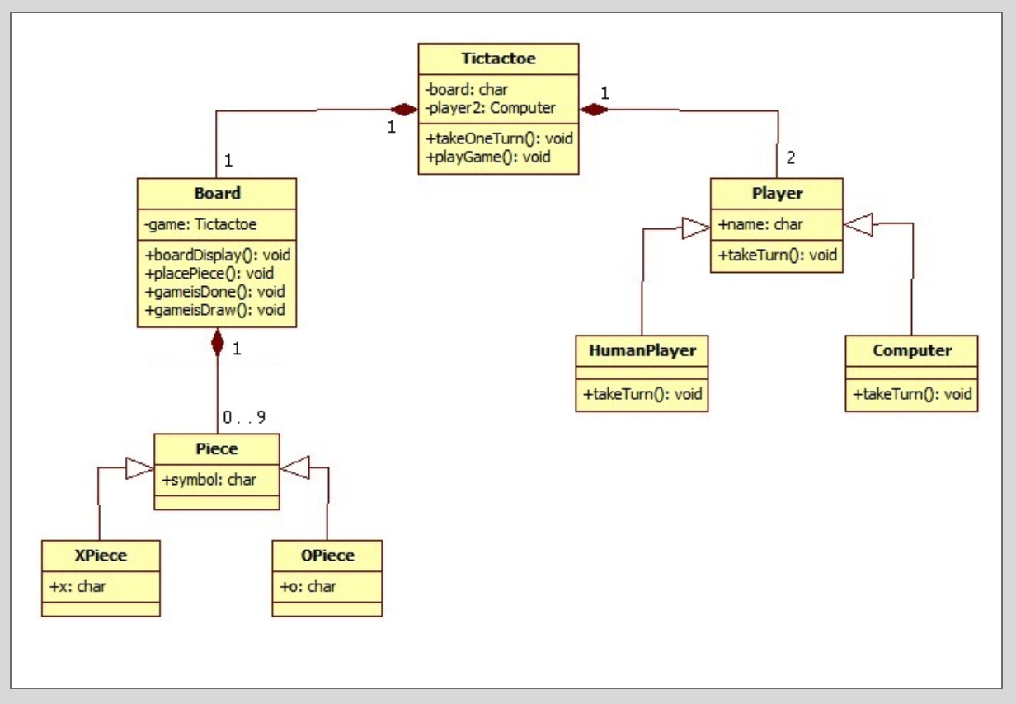
UML Diagram

Slide 5
Functional Requirements
Use Case 1:
Goals of actor: Register the user name .
Task: Register user name to log into the game and be able to play.
Preconditions :No registered user name
Exceptions: Display error message if user name is already taken.
Notes:
GOALS: To play the game during downtime, to be entertained and to win the game.
TASKS:

Slide 6
Non-Functional Requirements
Cost constraints
No cost constraints are foreseeable in the near future.
The project has a budget of $48,000.00 the monthly maintenance cost should not exceed $280.00 a month.
Reliability
The software should be usable, without any operational faults, for the period of time between its deployment and the following three years.
Time Constraints
Most meetings took place either after CS 3420 class and/or in Google Hangouts, Skype calls, and email in order to accommodate all group members with good schedules where we could all meet without running into any time constraints whilst building the application and filling out the required documents for the project

